Slide 1
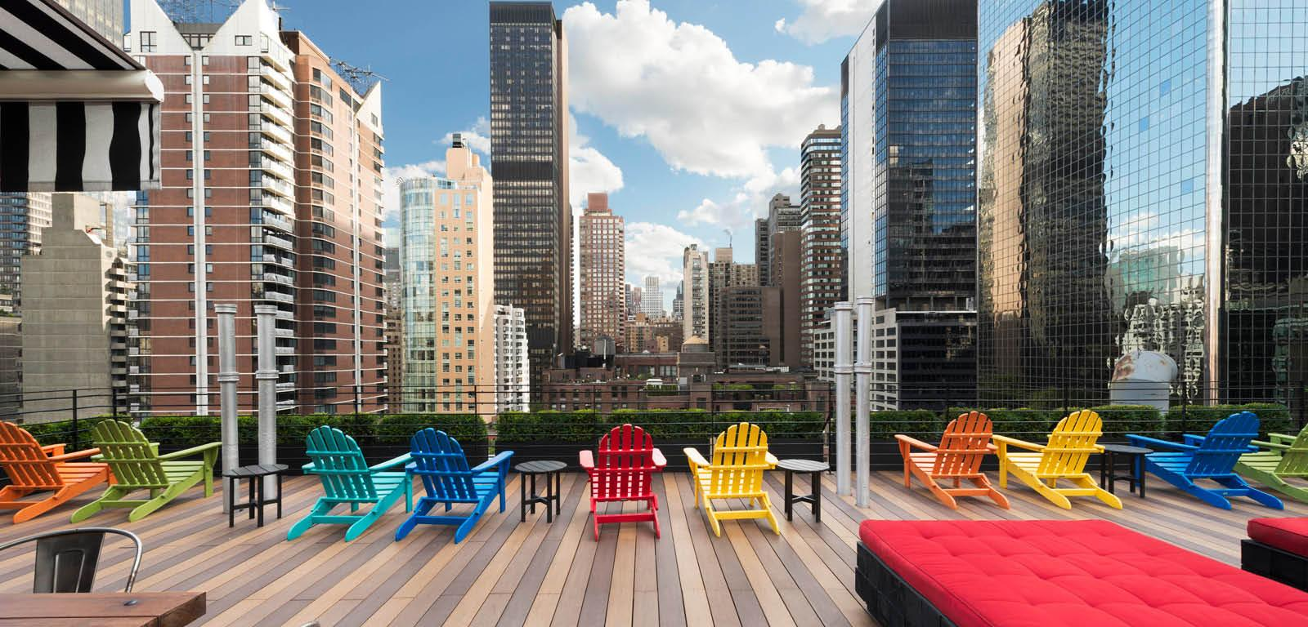
Predicting Cancelled Hotel Reservations
With Random Forest Modelling

Slide 2
Why are Hotel Cancellations a Problem?
Reduced room availability
Lost Revenues
Historic Rise in Cancellations
Notes:
Reduced room availability - reduced supply increases rates

Slide 3
The Data
119,390 reservations between 2015 and 2017 in Lisbon Portugal
Nuno Antonio, Ana de Almeida, and Luis Nunes “Hotel Booking Demand Dataset”, Elsevier
City Hotel and Resort Hotel
Demographic Data
Timing Data
Reservation Details
Notes:
https://www.sciencedirect.com/science/article/pii/S2352340918315191

Slide 4
Data Cleaning
Number of Adults, Children, and Babies
Market Segment and Distribution Channel
Company and Agent Number
Average Daily Rate
Notes:
Number of Adults ,Children, and Babies
checked whether reservations without adults were correct?
Changed all resevations without adults or children to - 2 adults
Missing Market Segment and Distribution Channels - replaced with modes
Company and Agent number
Some reservations under the dist.channel corportate were missing company numbers, I filled these in with the mode company number (not coutning 0, which stands for na)
Some reservations under the dist.channel ta/to were missing agent numbers, I filled these in with the mode agent number (no includinng 0)
-ADR
- for the 0 adr entries that were not marked as complimentary...with the average ADR which was $102.00 a night.

Slide 5

Cancellations
75,166
44,224

Slide 6


Guests

Slide 7

Market Segments

Slide 8

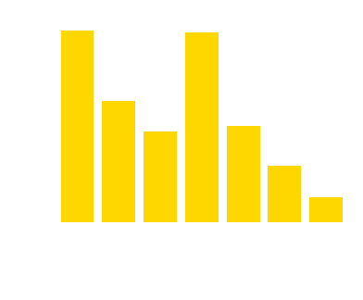
Reservation Timing

Slide 9
Average Reservation
Stay
Average: 2.5 nights
Standard Deviation: 1.6
Lead-Time
Average: 104 days
Standard Deviation: 107 days
Average Daily Rate
Average: €102.00
Standard Deviation: €49.41

Slide 10
Most Common Kept Reservation
2, 118 or 1.77% of all reservations:
Made 0 to 2 weeks before arrival
No deposit
1 adult
Reservation made with a Corporate Account
Guests were resident of Portugal
Reservation was not cancelled

Slide 11
Most Common Type of Cancelled Reservation
2,058 or 1.72% of all reservations:
Reservation made 9 to 12 months before arrival
Non Refundable Deposit
2 adults
0 Children
Group Market Segment
Guests are residents of Portugal
Notes:
The Group Market Segment - traditionally refers to reservations made related to a specific group event , such as a business conference, wedding, or other organized social gathering or convention. https://www.xotels.com/en/revenue-management/revenue-management-book/hotel-market-segmentation

Slide 12
Most Common Reservations by Season
Season | Cancelled | Lead-Time | Market Segment | Deposit | Adults | No. Reservations
Spring | No | 0-2 weeks | Corporate | None | 1 | 598
 | Yes | 3-6 months | Groups | Non Refundable | 2 | 944
Summer | No | 0-2 weeks | Online TA | None | 2 | 541
 | Yes | 9-12 months | Groups | Non Refundable | 2 | 850
Fall | No | 0-2 weeks | Corporate | None | 1 | 532
 | Yes | 9-12 months | Groups | Non Refundable | 2 | 901
Winter | No | 0-2 wks | Direct | None | 2 | 674
 | Yes | 2-3 mos | Groups | Non Refundable | 2 | 441
Notes:
All children values are 0
All dist channels are TA/TO
All countries are Portugal

Slide 13
Linear Classification Model
403 Features
Time:
Training: .28 seconds
Testing: 0. 08 seconds
Score:
Training: 81.8
Test: 81.6
Notes:
Trained and tested over 10 models
Adjusted penalty and C
Used both one hot encoded dummies and dummies from binary encoding

Slide 14
Random Forest Model
62 Features
125 trees
Time:
Training: 187.5 seconds
Test: 35.3 seconds
Score
Training: 83.5
Test: 81.6
Notes:
Final RFM model used defaults for max depth and max features
Binary encoded agents instead of one-hot encoded like in linear classification model
Training and test scores were cross-validated 10 times
Tested and trained over 15 RFC models
Used PCA in one model
Adjusted number of trees: 10-200 trees
Adjusted max depth: 2, 4, 6, 8, and 10
Adjusted max features: 2-5
Also tested 5 KNN models with 2-5 neighbors
Did not use SVM due to the size of the dataset

Slide 15
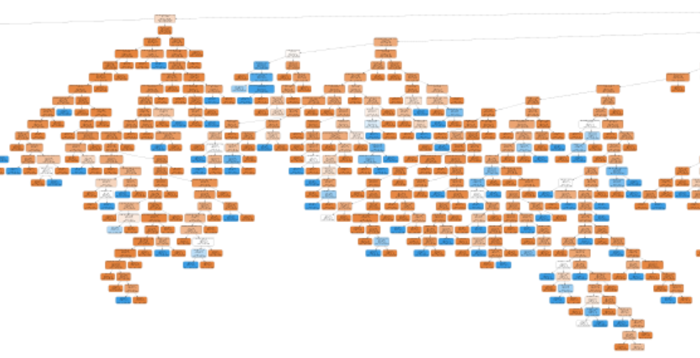
Random Forest Model

Slide 16
Comparing Model Performance
Linear Regression Model
Accuracy: .82
Precision: .81
Recall: 0.65
Random Forest Model
Accuracy: .84
Precision: .80
Recall: 0.75

Slide 17
Feature importance
Lead Time: 36.09%
Non-refundable Deposit: 15.58%
Number of Special Requests: 8.22%
Previous Cancellations: 4.68%
Number of Booking Changes: 3.49%

Slide 18
Implications and Suggestions
Better Balance in Data
Explore More Features or Reasons for Cancellations
Notes:
Notes on refundable or non refundable deposits

Slide 19
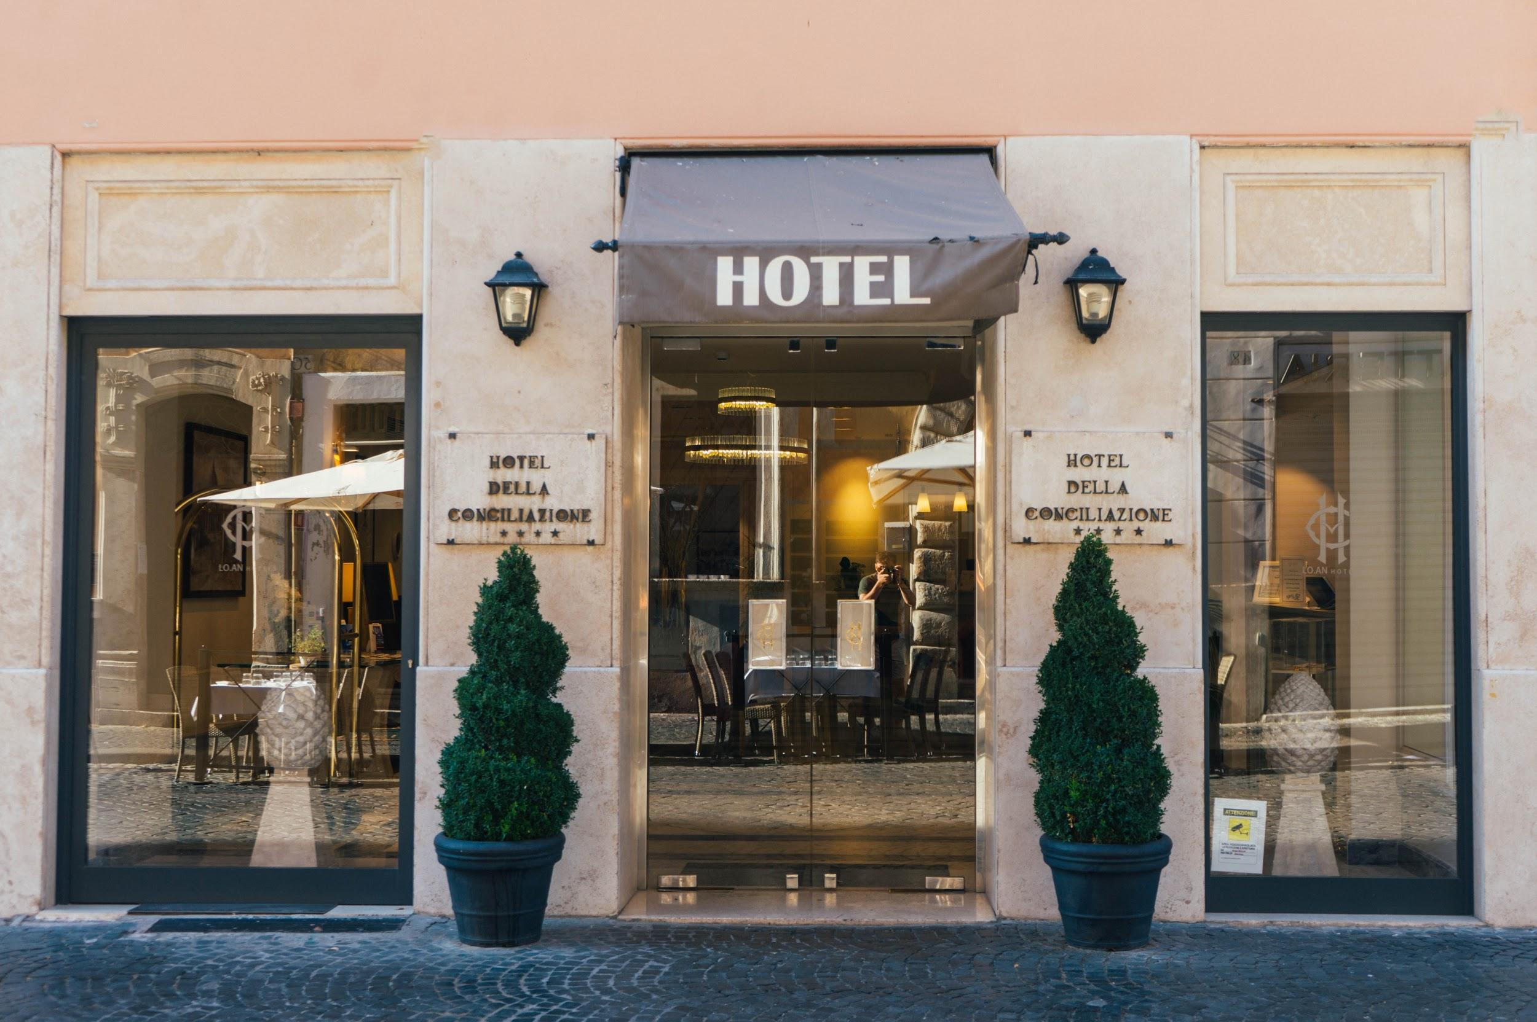
Thank you!

